Slide 1
Reorientation
2025-2026

Slide 2

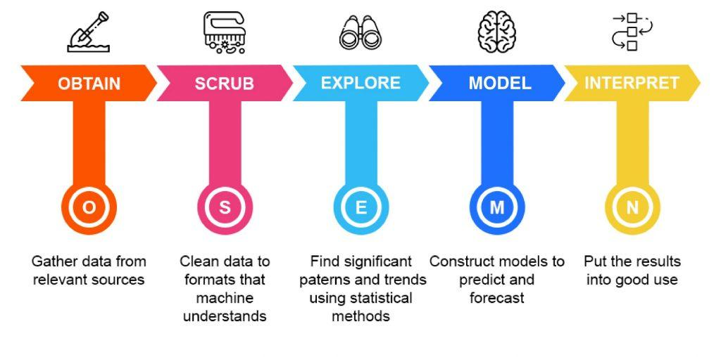
Do you remember?
The data science process: OSEMI
Project
AI course
Data viz course

Slide 3
Learning goal: Data Science in practice
Context: “From raw client data to a clear presentation for your manager”
Objectives:
Handle raw and messy data (S)
Clean and structure data for analysis (S)
Explore patterns and relationships (E)
Interpret and communicate actionable insight (I)
Notes:
🔄 OSEMI
O – Obtain (data verzamelen)
➡️ in de cursus via webscraping (BeautifulSoup), CSV/Excel inlezen, SQL, eventueel API’s. Doel: studenten kunnen data uit verschillende bronnen halen en samenbrengen.
S – Scrub (data wrangling & preprocessing)
Inhoud:
Data inspecteren (head, info, shape).
Missing values, duplicaten, inconsistenties behandelen.
Outliers detecteren & aanpakken.
Data transformeren (normaliseren, encoderen, datatypes corrigeren).
E – Explore (EDA)
Inhoud:
Beschrijvende statistieken (describe, mean, median, std,…).
Univariate analyse (histogram, boxplot).
Bivariate & multivariate analyse (scatterplots, correlatie, heatmaps, pairplots).
Tijdreeksen en trends.
Hypotheses formuleren: “lijkt X samen te hangen met Y?”.
M – Model
➡️ zie OPO AI
I – Interpret (rapportering & kritisch denken)
Inhoud:
Van cijfers en grafieken naar inzichten in gewone taal.
Beperkingen: correlatie ≠ causaliteit, datakwaliteit, bias.
Visual storytelling: juiste grafiek voor juiste boodschap.
Rapporteren voor “de baas”: korte samenvatting + aanbeveling.

Slide 4
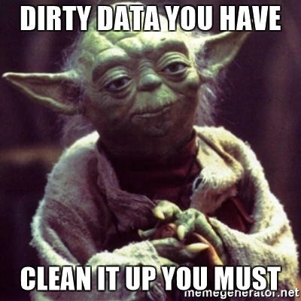
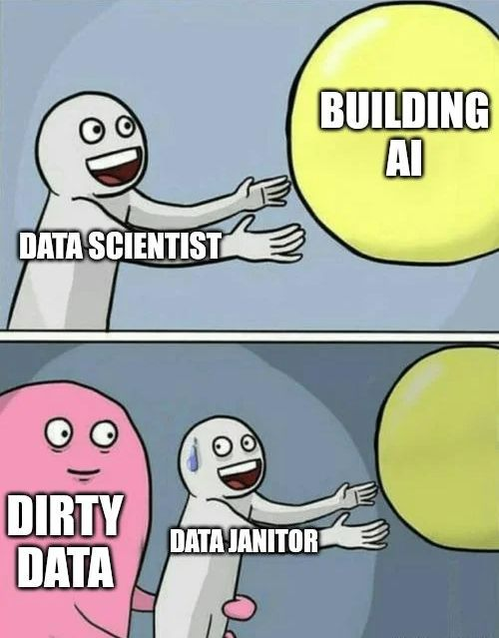
Scrub / Data Wrangling (once you got data….)
Raw data is often messy, incomplete, or inconsistent.
Before exploring, we need to clean and structure it.
Garbage in → garbage out

Slide 5
Scrub / Data Wrangling (once you got data….)
Steps during scrub
Inspect the dataset: shape, info(), head()
Handle missing values: remove, fill, or impute
Remove duplicates & inconsistencies: e.g., inconsistent spellings, wrong datatypes
Detect & treat outliers: using statistical or visual methods (boxplot, z-score)
Transform data:
Normalize / standardize numeric columns.
Encode categorical variables (one-hot, label encoding)
Rename columns / fix datatypes for clarity

Slide 6
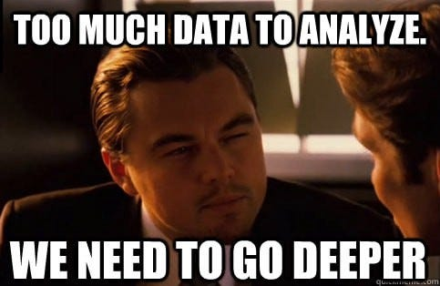
Explore & Discover (EDA)
“A first look at the data”
Exploratory Data Analysis helps you understand:
Patterns, relationships, and distributions in the data
Before building models or drawing conclusions
EDA turns cleaned data into actionable insights

Slide 7

What does an EDA include?
Possible components of an EDA
Descriptive statistics
Univariate exploration
Bivariate / multivariate analysis
Time trends
Data quality checks
Feature distributions by groups
…
EDA is not a fixed checklist
You select the techniques that are most relevant for your dataset and your goal
Always aim for: “What can I already learn from this data?”

Slide 8
What does an EDA include?
Descriptive statistics
Central tendency → what is a “typical” value in the data? (e.g., average, median)
Spread/variability → how much do the values differ from each other? (e.g., wide vs narrow distribution)
Shape of distribution → is the data symmetric, skewed, or multi-peaked?
Unusual values → spotting anomalies or outliers that might distort the analysis
Univariate analysis (single variable)
Numeric: histogram, boxplot, violin plot
Categorical: bar plot, value counts
Bivariate / multivariate analysis
Numeric vs numeric: scatterplot, correlation heatmap
Numeric vs categorical: boxplot, violin plot
Multivariate: pair plot, clustering patterns
Time series / trends
Line plots, moving averages, seasonal trends

Slide 9
Interpret & Communicate
Data and graphs alone are not enough
→ The real value lies in the story you tell
Managers/clients need clear insights and recommendations (not raw numbers)
Goal
Turn technical findings into actionable business insights
Communicate so that non-technical audiences understand

Slide 10
Interpret & Communicate
Translate results into plain language
What does the average, trend, or correlation actually mean?
Identify limitations
Correlation ≠ causation, small sample sizes, data quality issues
Choose the right visualization for the message
Highlight patterns, avoid clutter
Communicate concisely
Focus on what matters for the decision-maker
End with recommendations
What action should be taken based on these insights?

Slide 11
Key elements
From numbers to insights
What does a median, a correlation, or a cluster actually mean?
Limitations & pitfalls
Correlation ≠ causation
Small samples
Bias in data
Avoid overinterpretation
Translate results into plain language
Use simple words, avoid jargon
Visual storytelling
Pick the right chart for the right message
Reporting to your manager
Focus on the one thing they must remember
Keep it short: an executive summary
Notes:
Correlation ≠ causation: students that were in a fraternity make more money, even though the often had less good grades. The fraternity may be the cause, but could it be that poor students (who have to work and don’t have time for a frat) don’t have the same network as those with rich parents and take longer to make a career? What I’m telling here are not facts, they are interpretations that you should avoid, and they serve as a cautionary tale to not see causality where there is correlation.

Slide 12
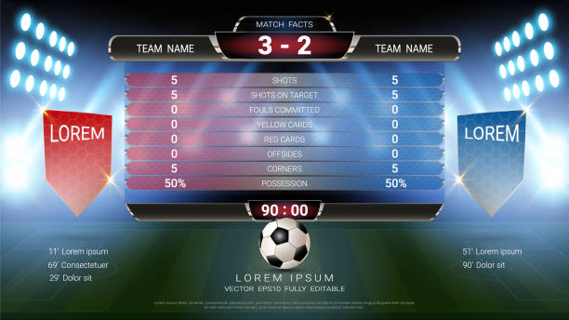

Findings vs. Conclusions
Findings = What the data shows (facts)
Factual results from the data/EDA
e.g., “Sales are 20% higher in Region A than Region B.”
Conclusions = What it might mean (interpretation)
Interpretation + implication for the business
e.g., “Region A is outperforming, so resources should be shifted there.”
Rule of thumb:
Findings = “what the data shows.”
Conclusions = “what the decision-maker should take away.”

Slide 13
⚠️ Important
EDA gives findings for sure
Conclusions are often hypotheses, not proofs ⚠️
To confirm conclusions → need models, experiments, or external context
EDA = safe for findings, cautious for conclusions

Slide 14
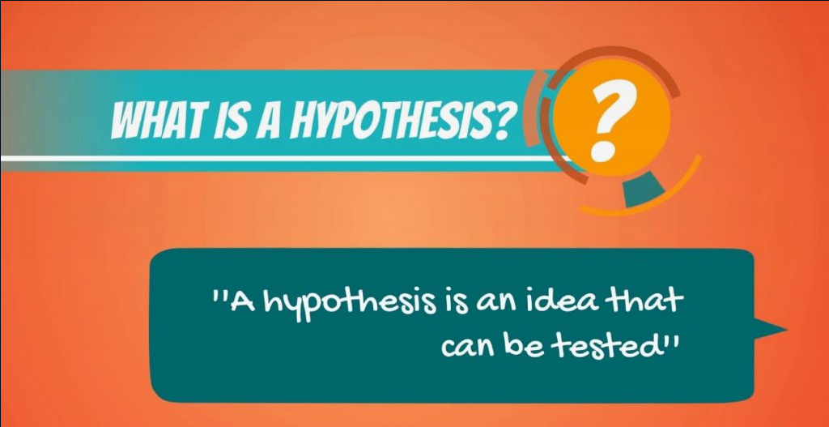
From Findings to Hypotheses
What is a hypothesis?
A testable statement about a possible relationship or pattern in the data.
Goes beyond describing what you see → suggests why it might happen.
Notes:
https://365datascience.com/tutorials/statistics-tutorials/null-hypothesis/

Slide 15
How to form a hypothesis
Start with a finding
e.g., “Region A has 20% higher sales than Region B.”
Ask ‘Why?’
Could it be marketing spend? Customer demographics? Seasonality?
Propose a possible explanation (your hypothesis)
“Higher sales in Region A are due to a stronger online marketing campaign.”
Make it testable
Identify data or methods that could confirm or reject it.

Slide 16
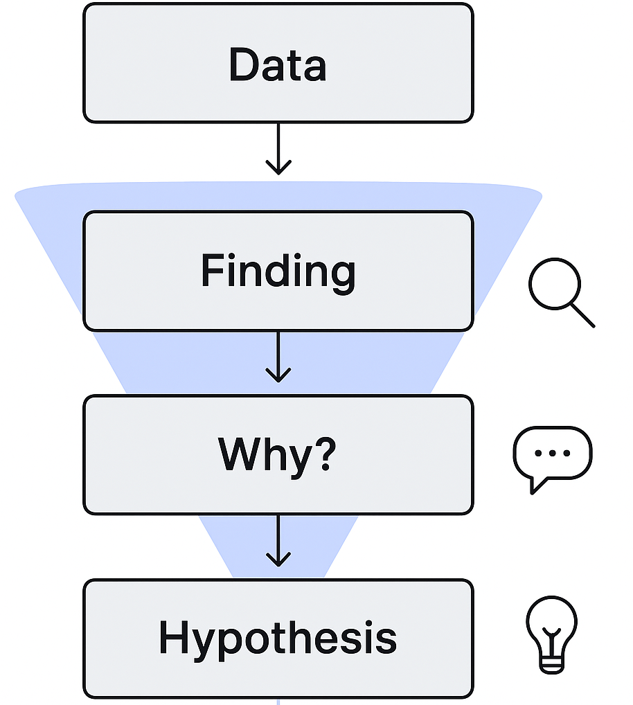
Good hypothesis checklist
Clear: one specific idea, not vague
Testable: can be checked with data or further analysis
Relevant: linked to the business question
EDA not as the end, but as the start of deeper inquiry.

Slide 17
Examples
1. Predictive hypothesis
"Students who spend at least 3 hours per week on online exercises are more likely to score above 80% in the Data Science course."
2. Correlation hypothesis
"There is a positive correlation between the number of hours a person exercises per week and their average sleep duration."
3. Group comparison hypothesis
"Employees who participate in team projects score on average 10% higher on quarterly performance evaluations than those who work individually."
4. Intervention effect hypothesis
"Sending weekly reminder emails increases the likelihood that users will remain active on a mobile app after one month."
5. Behavioral hypothesis
"Customers who frequently open promotional emails are more likely to make a purchase within 30 days than those who do not."

